Slide 1






C++ Modules
conservative, but not entirely bad
Man, you’re so lame...
Notes:
First of all, I’m sort-of following Alexandrescu’s steps here and using the opening slide just to crack some silly jokes.
You all can appreciate my artistic talent here.
This is an accurate representation of C++. (Pointing on C++ logo.) If you look at it’s core, it actually looks rather good.
(Pointing on the beard.) But it’s old.
(Pointing on the hat.) And it does some weird crap sometimes.

Slide 2
Mundale Reality
Source files, header files, text inclusion and separate compilation:
slow to compile
ODR violations
lack of encapsulation
cyclic dependencies
order dependencies
Notes:
ODR violations:
It’s an error to have different declarations/definitions of the same name in different translation units.
Example: Some kind of DEBUG macro defined in one source file, but not in the other, prior to inclusion of (the same) header.
Lack of encapsulation:
Due to the nature of C++ we, sometimes, have to expose implementation details of concrete classes. Like, the stuff you put into details or impl namespace. But we have no way to restrict the access to such entities.
And, of course, macro definitions. With text-inclusion model we have macroses going in and out of header files freely.
Order dependencies:
With text-inclusion model it’s easy to create order-dependent headers.
Example: header foo.h requires header bar.h, but does not include it. Then, in source file we may happen to include header bar.h first and header foo.h after that.
Cyclic dependencies:
We may have two header files mutually including each other. Such inclusions are resolved with include guards and forward declarations. They are not inherently bad, but they indicate a close dependency between entities stored in this separate headers.

Slide 3
So, do modules solve our problems? Are they good?

Slide 4
Yes.

Slide 5
Yes..

Slide 6
Yes...

Slide 7
Yes… and no.

Slide 8
Yes… and no. But yes.

Slide 9
State of the Art
Modules provide:
modular interface
proper encapsulation
“top-down” and “bottom-up” isolation
order independency of imports
And, as a possible byproduct of such design, shorter build times.
Notes:
Modular interface:
The entire public interface of the module is declared in a single translation-unit. Implementation of the module could be splitted between several translation units.
Proper encapsulation:
Only entities which are explicitly declared as exported by a module will be visible to consumers.
“Top-down” and “bottom-up” isolation:
Macro definitions, generally, don’t go neither in from importing into imported module, nor out of imported into importing module.

Slide 10
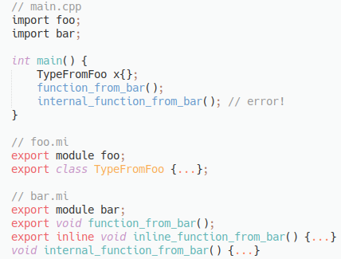
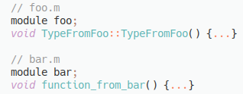
Basics
Notes:
main.cpp is ordinary.
import statement is obvious
export declaration is obvious
*.mi extension - module interface units
*.m extension - module implementation units
file extensions are arbitrary
module names are not tied to neither file names, nor to namespaces
export module-declaration denotes module interface unit
module-declaration without export keyword denotes module implementation unit
names exported with export declaration have external linkage
names defined in module units, but not exported with export declaration have module linkage; they are visible only inside the module in which they are defined
the word unit is not a coincidence
there are no textual-inclusio, each one of this files is a separate translation-unit
that’s why there is a definition of internal_function_from_bar in bar.mi

Slide 11
Translation Units
Non-Modular Unit no module-declaration
Module Interface Unit export module <module-name>; 1 Module Interface Unit per module
Module Implementation Unit module <module-name>; 0 or 1 Module Implementation Unit per module

Slide 12
Compilation Model
foo.cmi
foo.im
compile
compile
foo.m.o
foo.i.o
foo.m
foo.im
compile
foo.cmi
compile
foo.o
...

Slide 13
Problems with Modules Compilation Model
order dependencies
modules lookup
More or less everything regarding build process is implementation-defined. And there are no consensus on how to best implement it yet.
But TR is promised post-C++20 release.

Slide 14
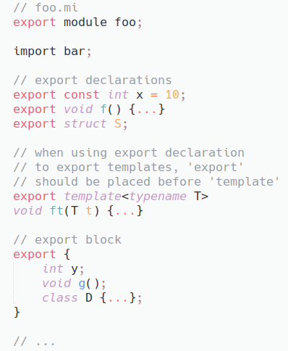
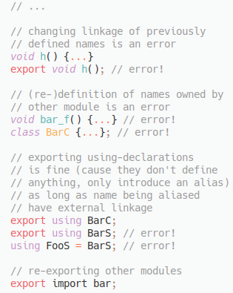
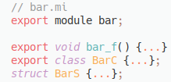
All About Exports

Slide 15
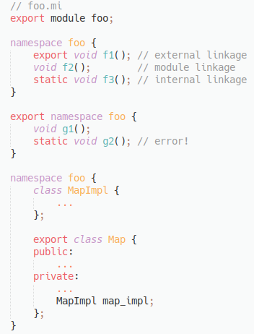
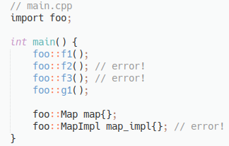
Modules and Namespaces

Slide 16
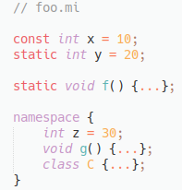
Modules and Static Linkage

Slide 17
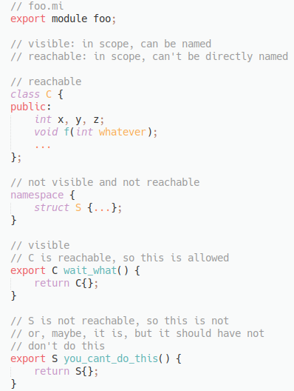
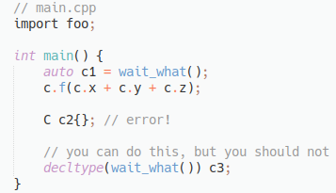
Visibility and Reachability

Slide 18
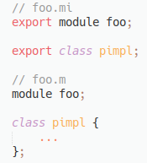
Module Private Fragments

Slide 19
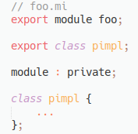
Module Private Fragments

Slide 20
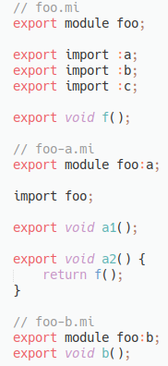
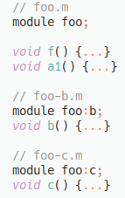
Splitting Modules: Module Partitions

Slide 21
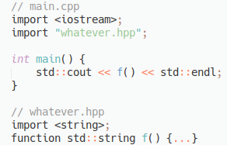
Turning Headers into Modules: Header Units

Slide 22
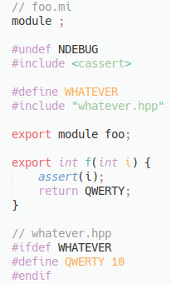
Mixing Modules and Headers: Global Module Fragment

Slide 23
How Can I Try Modules Right Now?
GCC “modules” branch: svn://gcc.gnu.org/svn/gcc/branches/c++-modules
Clang 8.0 have -fmodules-ts flag, but everything is completely undocumented
Clang 9.0 (currently in development) have tests for modules, so one can infer how they could be used

Slide 24
C++ Modules: GCC
Modules support should be enabled with -fmodules-ts
GCC auto-generates compiled module interface, when you compile module interface units
Compile your module interfaces before you compile your module implementations

Slide 25
C++ Modules: Clang (UNTESTED)
Modules support should be enabled with -fmodules-ts
Clang requires you to explicitly compile your module interfaces: clang++ -fmodules-ts -emit-module-inteface <module-interface-unit> -o <compiled-module-interface>
Clang requires you to explicitly specify all required compiled module interface files, when building module implementation or non-module units: clang++ -fmodules-ts -fmodule-file=<compiled-module-interface> <translation-unit>

Slide 26
Questions?

